Slide 1

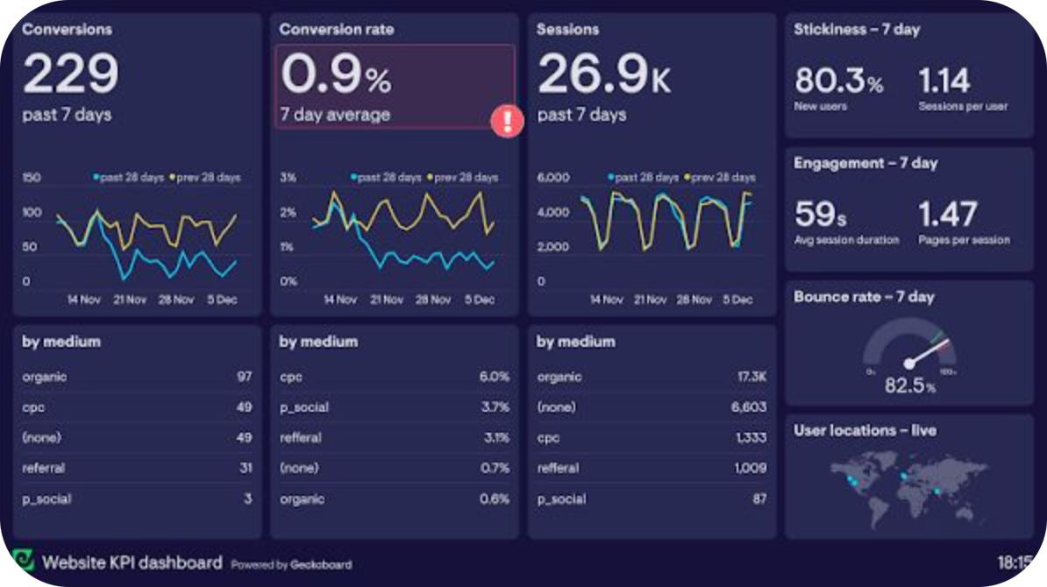
SUPPORTLYTICS
Optimizing IT Support Team Performance Using Analytics
Module 7 — Dashboard & Report Preparation
Transforming support-ticket data into interactive and actionable insights.
By
Uma Parvathi Devi Nakireddy

Slide 2
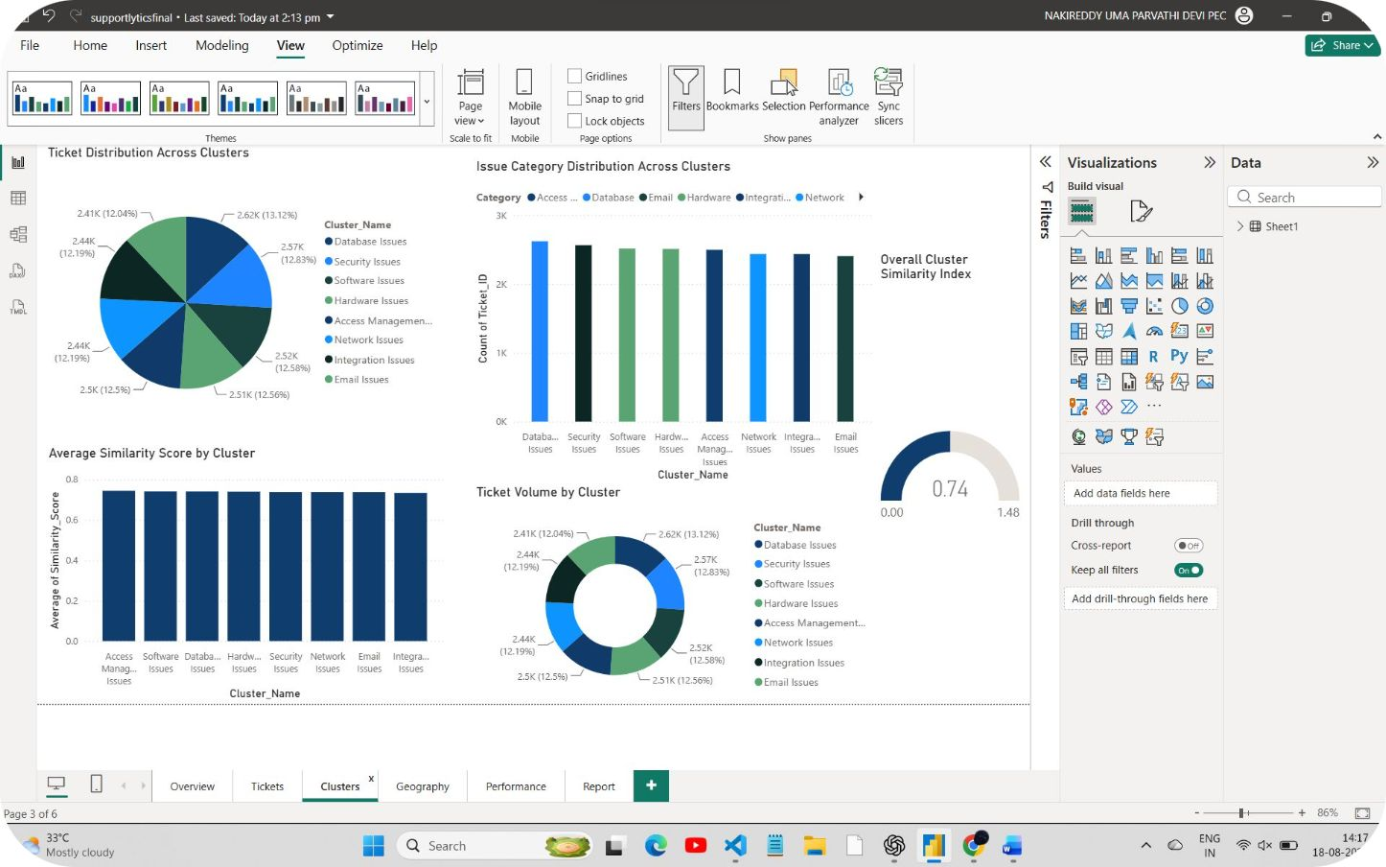
Module 7 — Dashboard & Report Preparation
Objective
The purpose of this milestone was to consolidate previous analyses into an interactive Power BI report that supports exploration and decision-making.
Loaded the project dataset into Power BI.
Created KPI cards and analytical visualizations.
Organized the dashboard into separate analytical pages.
Combined ticket, category, cluster, geographic and performance analysis.
Created an executive report page.
Prepared the final dashboard for presentation and decision-making.

Slide 3


From Data to Interactive Dashboard
The project data was transformed into interactive Power BI visualizations to make support-ticket patterns easier to understand and interpret.

Slide 4
Power BI Report Structure
The report is organized into six focused pages that guide analysis from high-level KPIs to executive summary.
Overview
Tickets
Clusters
High-level KPIs and overall support-ticket picture.
Status, priority, channel, ticket type and issue categories.
Cluster distribution, similarity analysis and issue patterns.
Geography
Performance
Report
Regional and country-level ticket analysis.
Resolution time, satisfaction and operational metrics.
Executive summary for decision-makers.

Slide 5
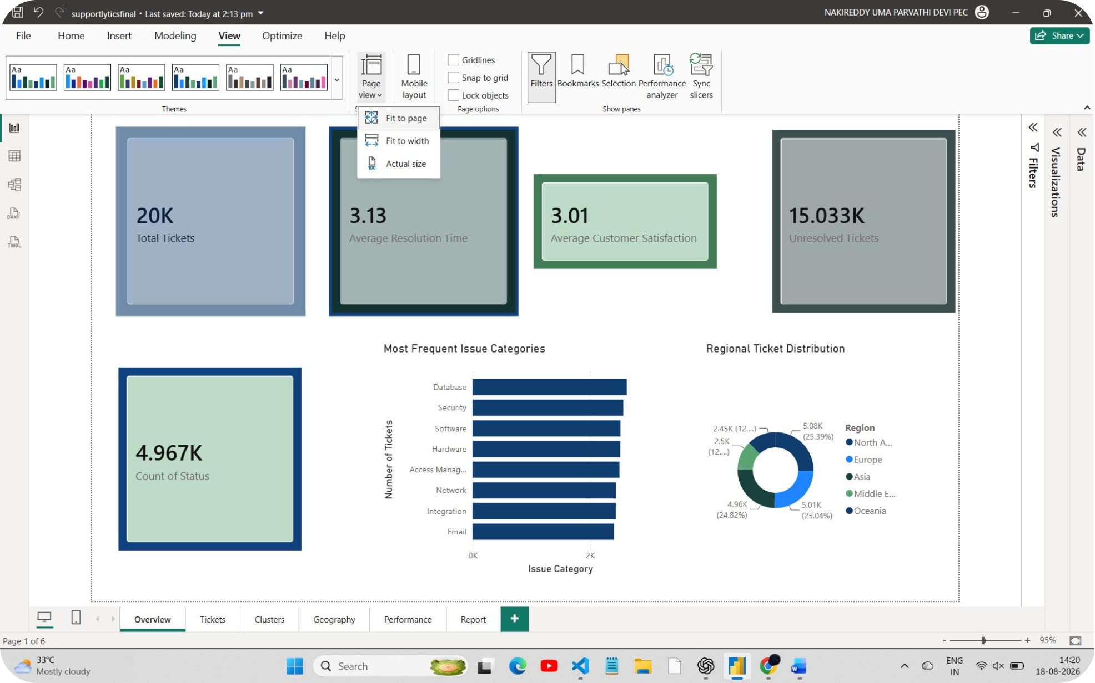
Page 1 — Overview
Overview Visualizations
Total Tickets — Shows the total number of support tickets in the dataset.
Average Resolution Time — Shows average time to resolve tickets.
Average Customer Satisfaction — Shows average satisfaction score.
Ticket Status Summary — Distribution of tickets by status.
Most Frequent Issue Categories — Top recurring issue categories.
Regional Ticket Distribution — Tickets distributed across regions.
This page provides a quick overview of the overall support workload and key performance indicators.

Slide 6
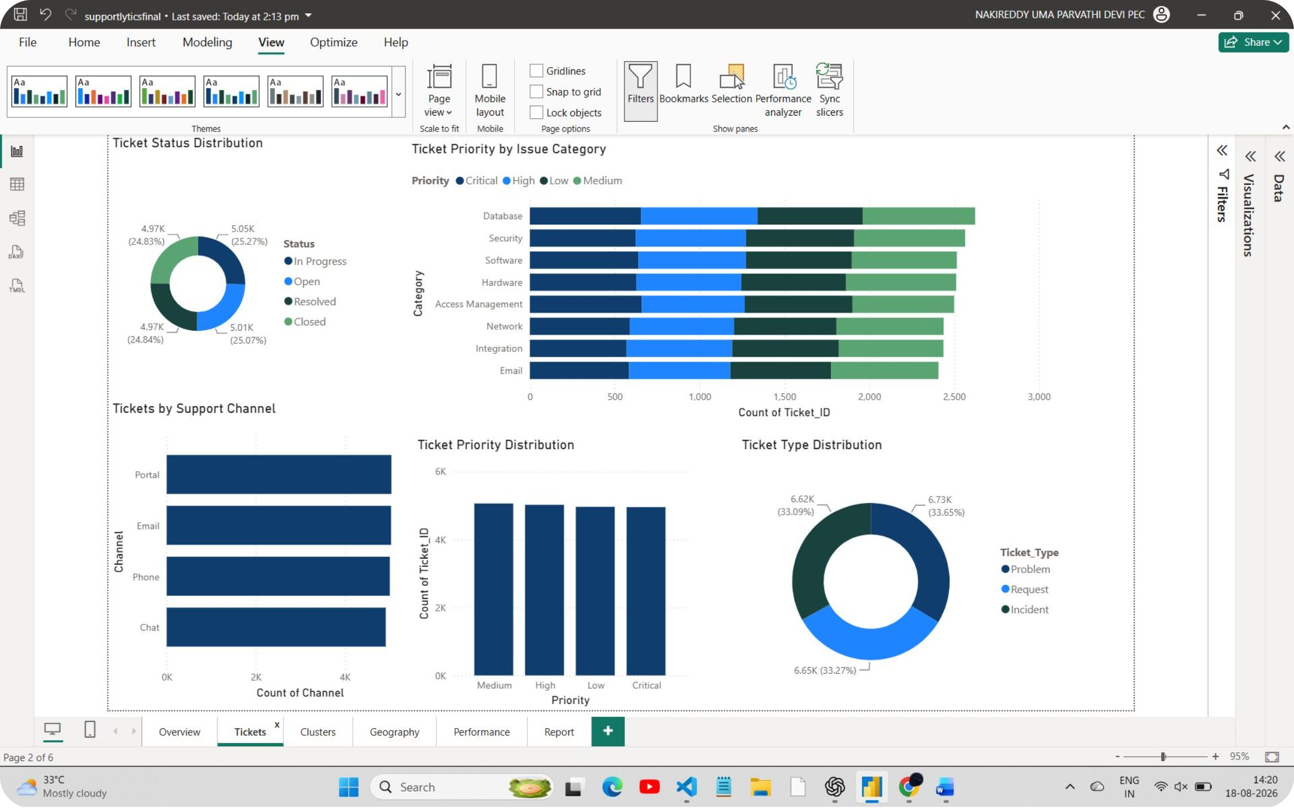
Page 2 — Tickets & Categories
Ticket Visualizations
Ticket Status Distribution — Open, In Progress, Resolved, Closed.
Tickets by Support Channel — Distribution across channels (email, portal, phone).
Ticket Priority Distribution — Low/Medium/High/Critical breakdown.
Priority by Issue Category — How priorities vary by category.
Ticket Type Distribution — Problem, Request, Incident.
Issue Category Distribution — Frequency across categories.
This page provides a detailed view of request types, their status, priority and categories.

Slide 7
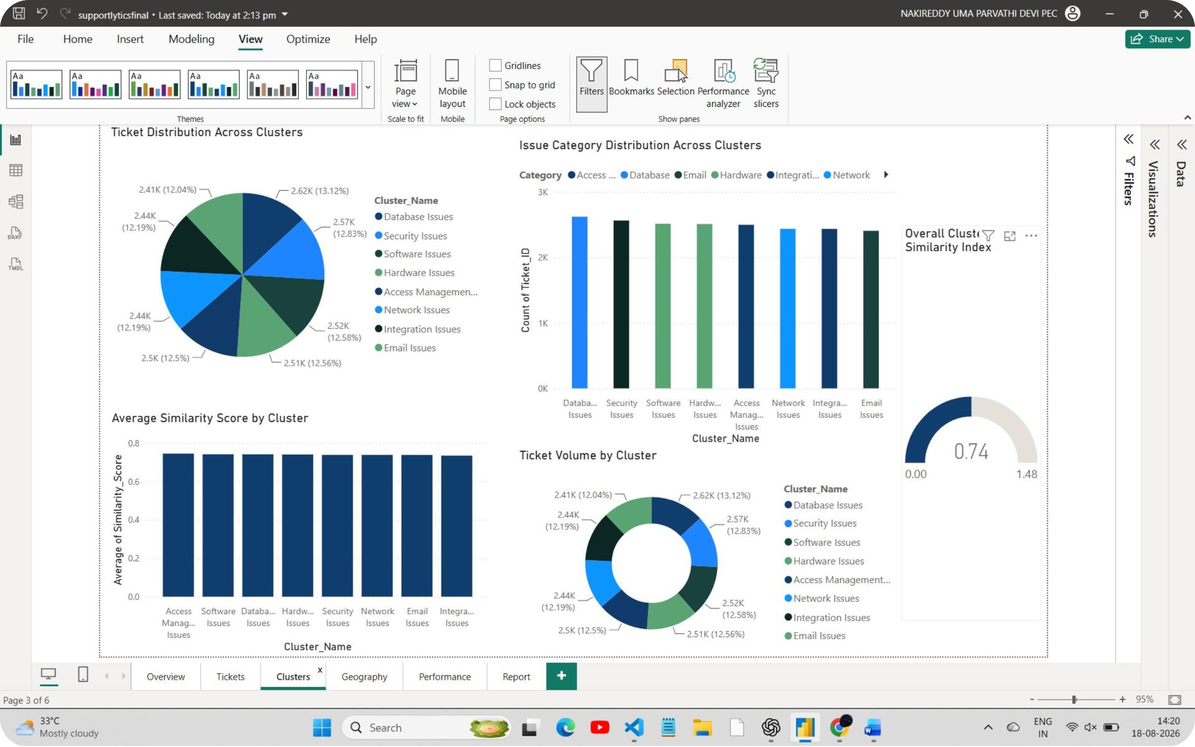
Page 3 — Clusters & Similarity
Cluster Visualizations
Ticket Distribution Across Clusters — How tickets map to identified clusters.
Average Similarity Score by Cluster — Mean similarity within each cluster.
Issue Category Distribution Across Clusters — Category patterns per cluster.
Ticket Volume by Cluster — Ticket counts per cluster.
Overall Cluster Similarity Index — Summary of clustering coherence.
Cluster analysis groups similar issues and helps identify recurring patterns. Do not state specific similarity values here — they appear in the dashboard screenshot.

Slide 8
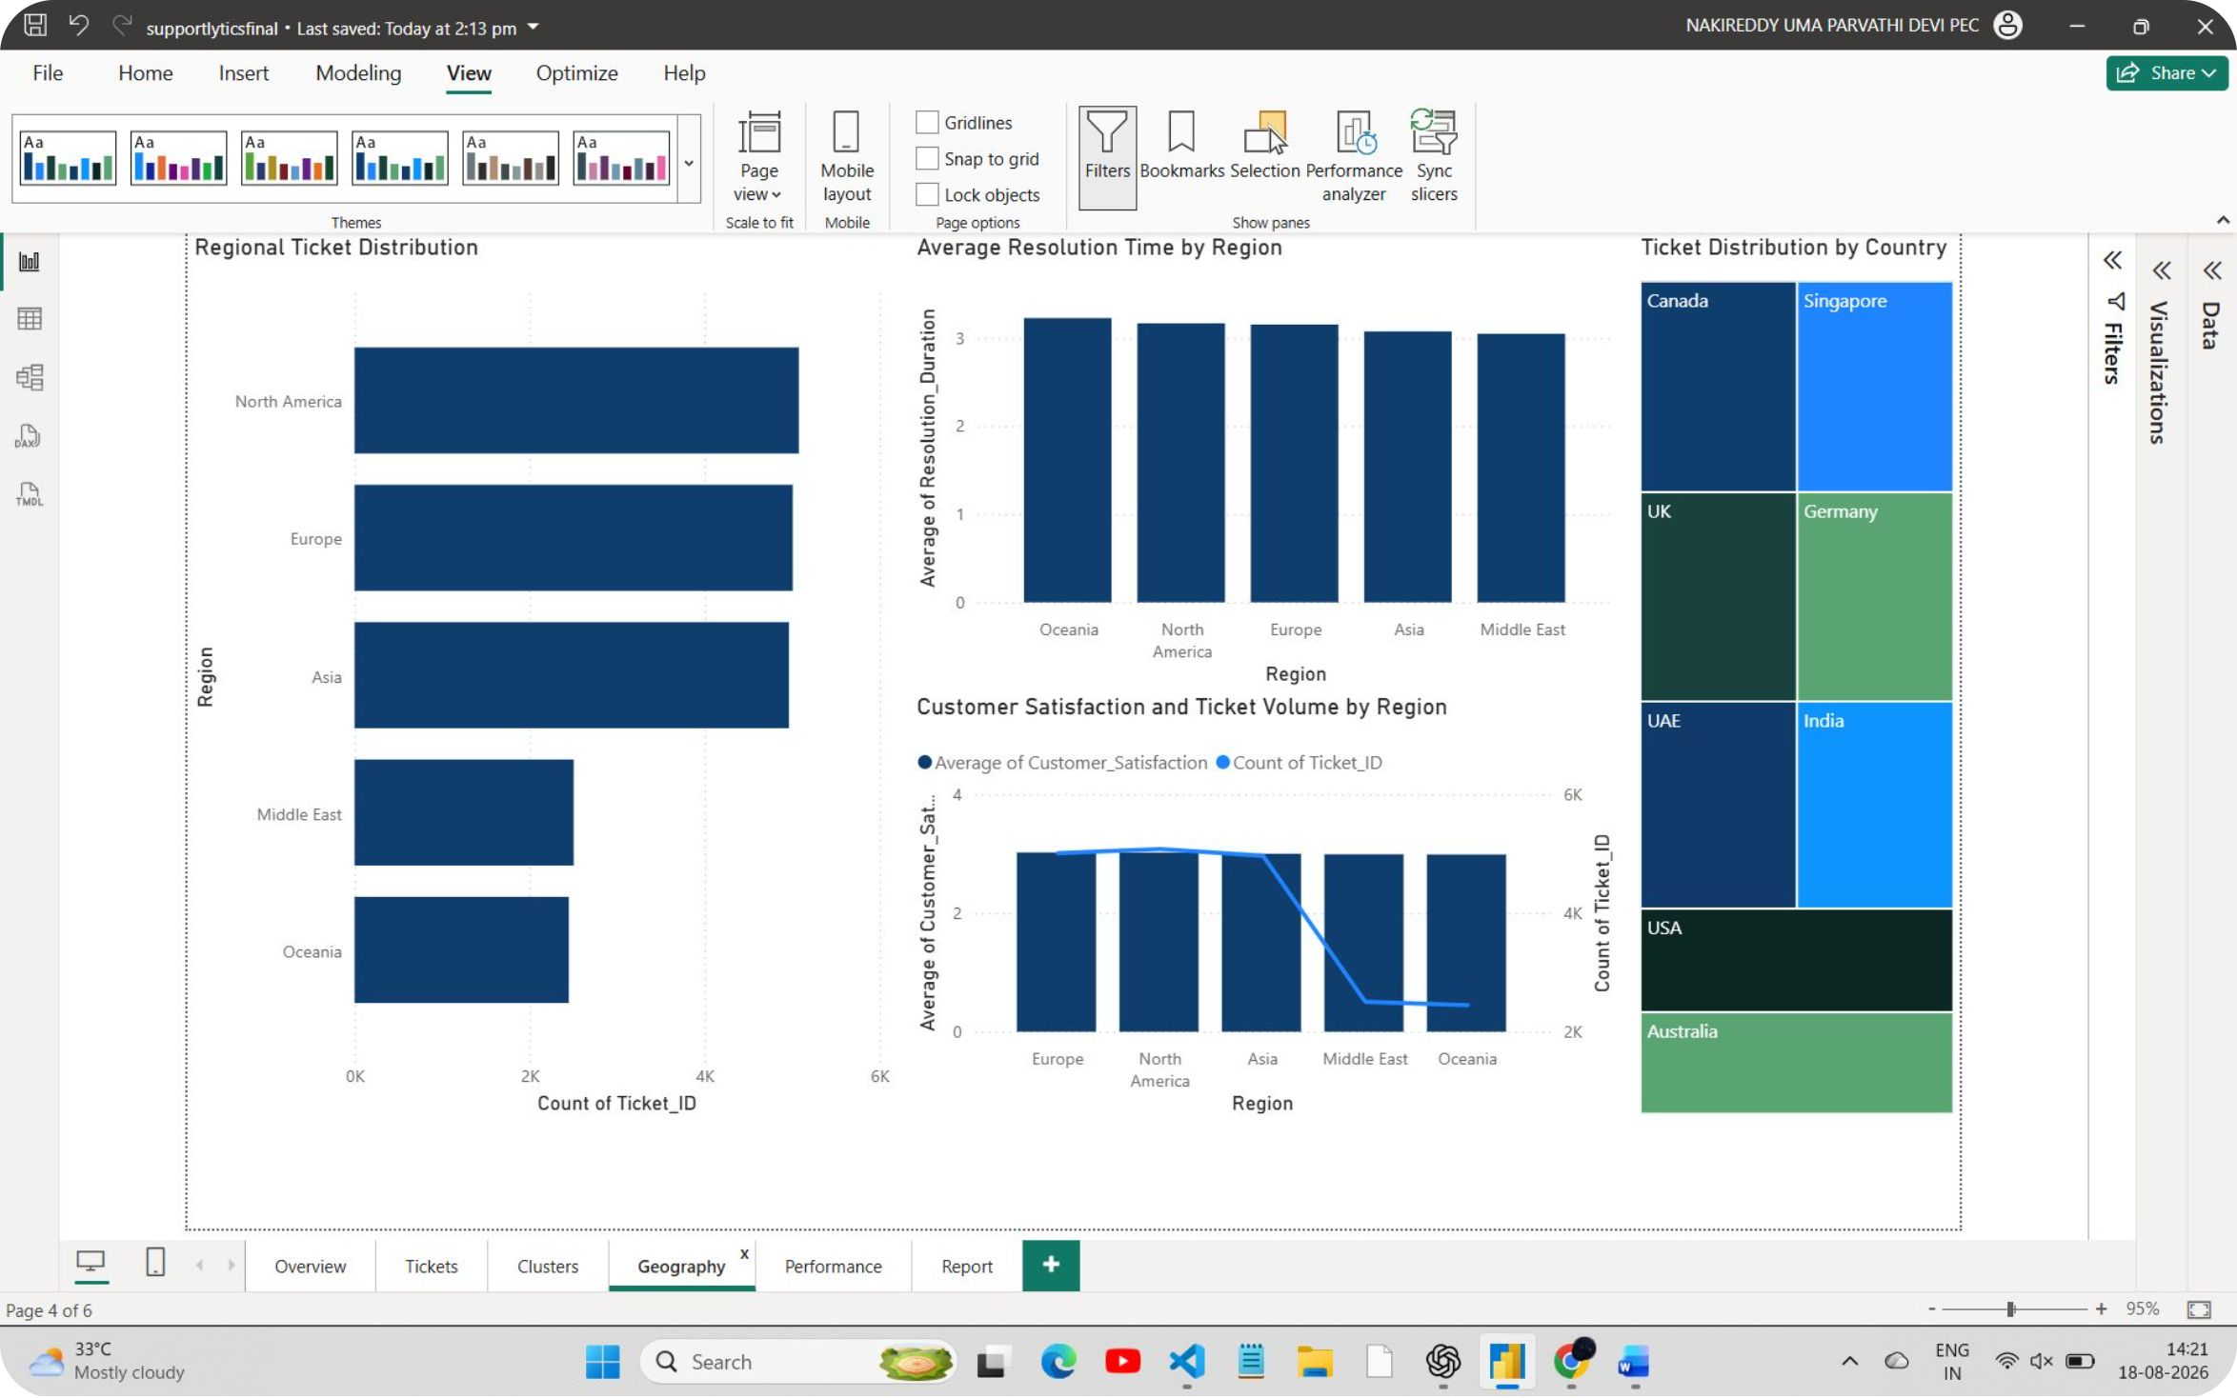
Page 4 — Geography
Geographic Visualizations
Regional Ticket Distribution — Tickets by region.
Average Resolution Time by Region — Regional resolution comparisons.
Ticket Distribution by Country — Country-level breakdown.
Customer Satisfaction by Region — Regional satisfaction comparisons.
Regional Performance — Differences in operational performance by region.
This page helps identify geographic differences in workload, resolution efficiency and satisfaction. Use only visuals enabled in Power BI (do not assume map availability).

Slide 9
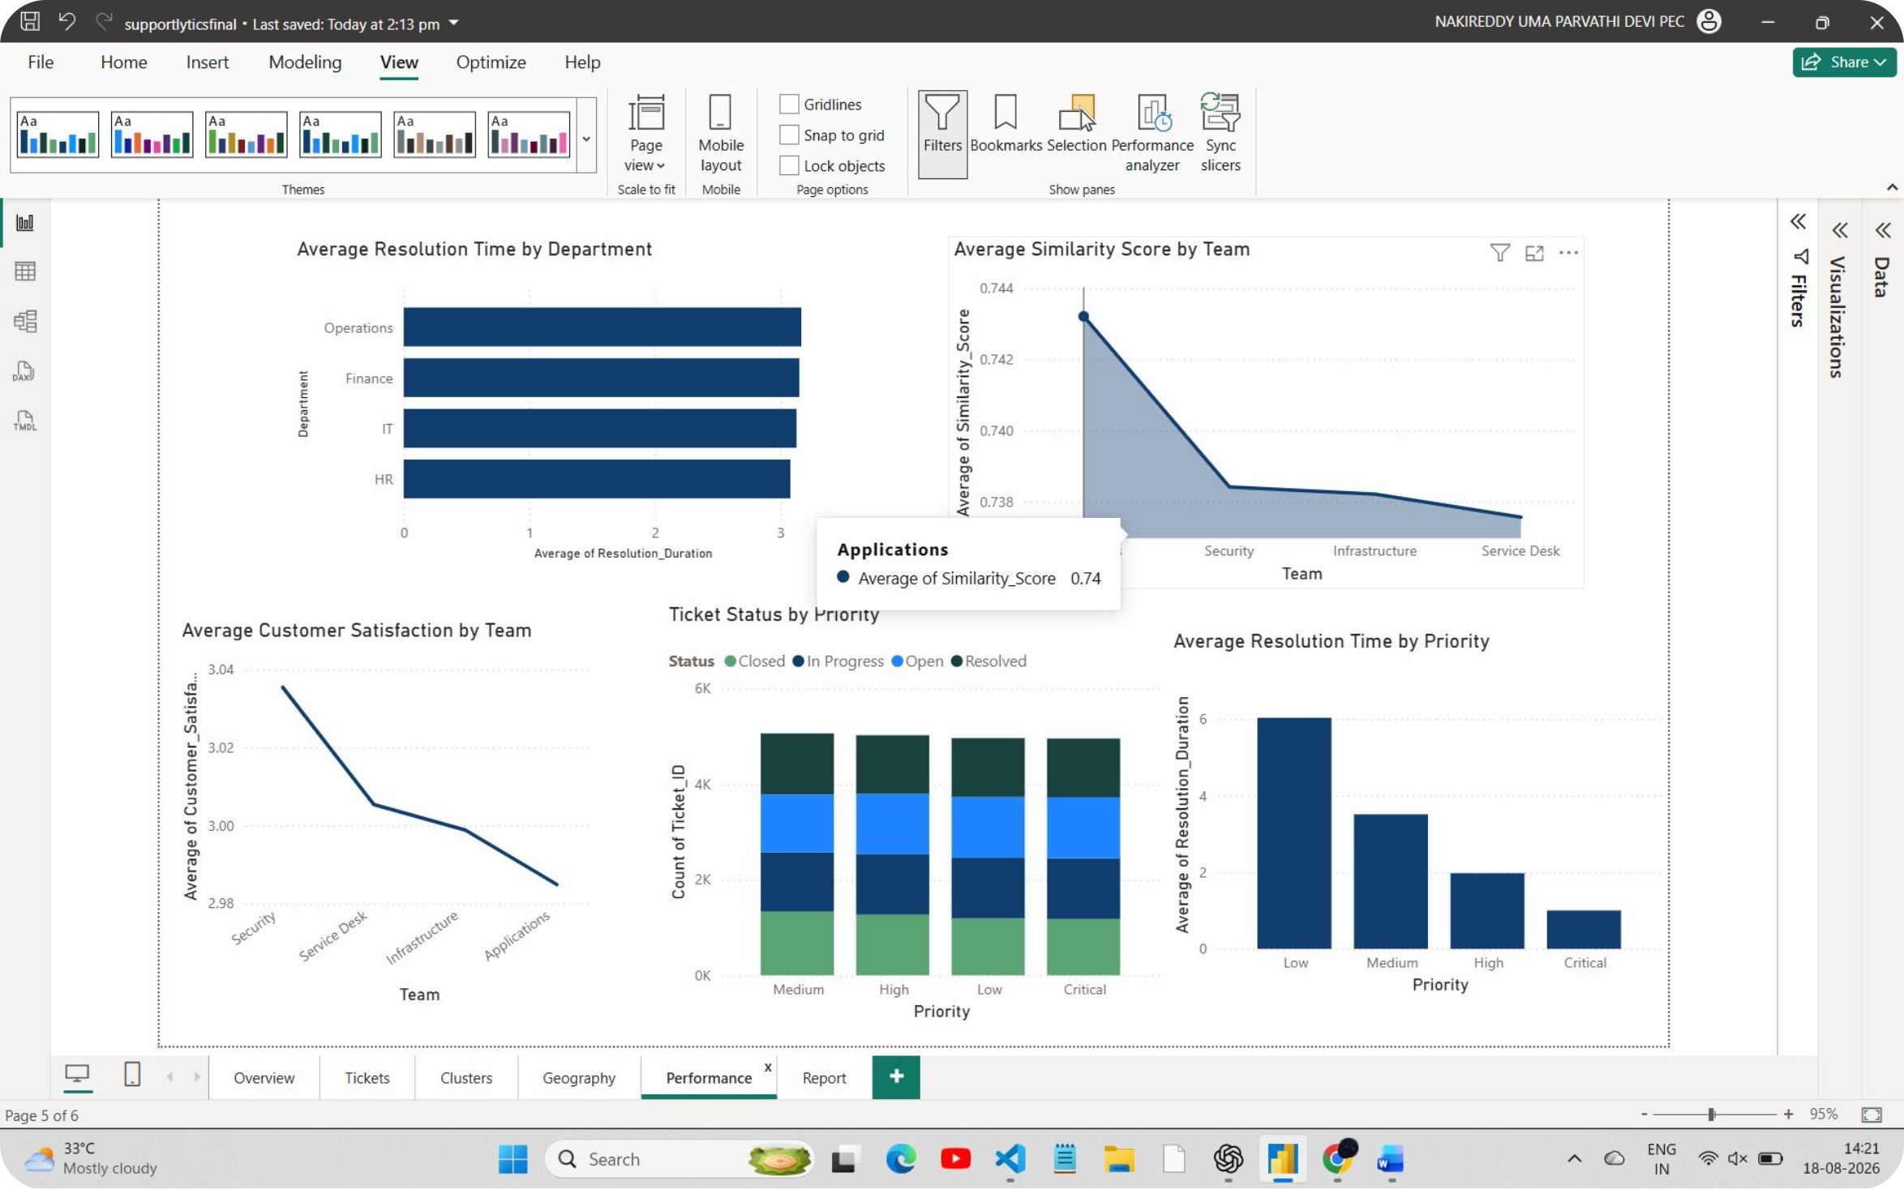
Page 5 — Performance
Performance Visualizations
Average Resolution Time by Department — Compare resolution times across departments.
Average Customer Satisfaction by Team — Satisfaction per support team.
Average Resolution Time by Priority — Resolution differences by priority level.
Ticket Status by Priority — Relationship between priority and status.
Average Similarity Score by Team — Similarity of tickets handled per team.
This page focuses on operational efficiency, service quality and team-level differences. Only include visuals actually present in the final Performance page.

Slide 10
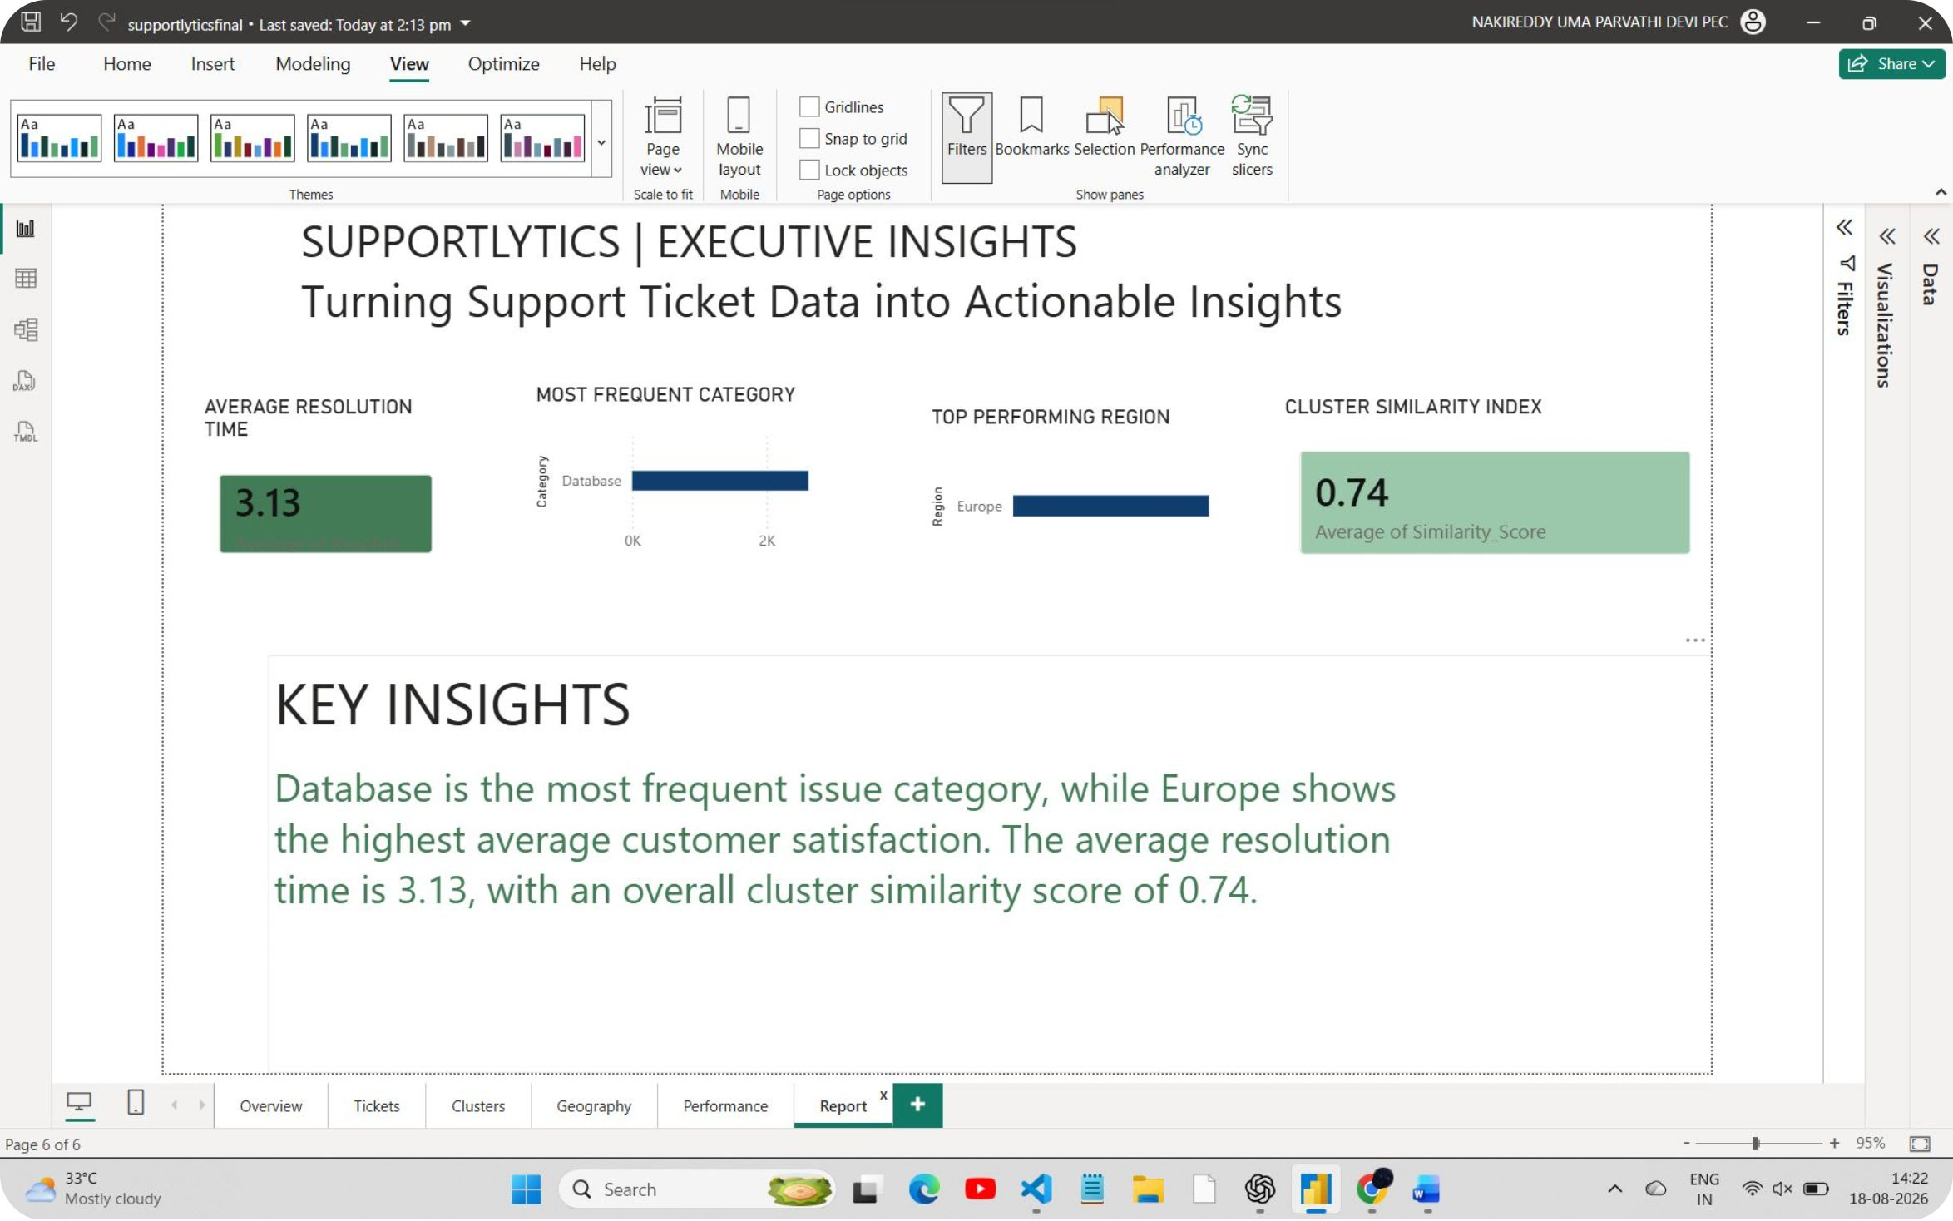
Page 6 — Executive Report
Executive Insights
Average Resolution Time — Executive summary of overall resolution performance.
Most Frequent Category — Issue category with highest ticket frequency (dashboard value).
Top Performing Region — Region highlighted by the dashboard's chosen performance measure.
Cluster Similarity Index — Overall clustering summary (see screenshot for value).
Key Insights — Concise summary of the major findings from the complete dashboard.
This page converts detailed analysis into an executive-level summary for quick decision-making. Do not invent numerical values; refer to the pasted screenshot for specifics.

Slide 11
THANK YOU

